Slide 1

A PROJECT PRESENTATION ON
CUSTOMER CHURN ANALYSIS AND PREDICTIVE REPORTING USING MACHINE LEARNING AND POWER BI
BACHELOR OF SCIENCE IN DATA SCIENCE
SUBMITTED BY
GROUP NO 02
PRN | NAME OF THE STUDENT
2401202016 | Dipannita Pramanik
2401202043 | Sanjivani Sathe
2401202023 | Kanak Ghanekar
2401202004 | Anant Singhal
2401202083 | Gouri Juvekar
UNDER THE GUIDANCE OF
Dr. Abhijeet Thakur
SCHOOL OF DATA SCIENCE
SYMBIOSIS SKILLS AND PROFESSIONAL UNIVERSITY, PUNE
ACADEMIC YEAR 2025-26

Slide 2
CONTENTS
Introduction
Literature Review/ Background Study
System Design & Methodology
Data Collection & Preprocessing
Model Development / Implementation
Results & Analysis
Integration of Subjects
Conclusion & Future Work

Slide 3
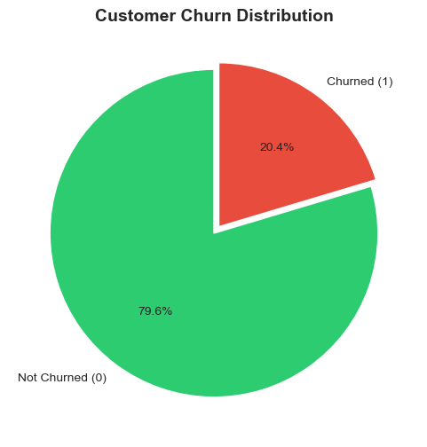
INTRODUCTION
Overview
Customer churn occurs when customers stop using a bank's services. This project builds an end-to-end system integrating MySQL, Machine Learning, Power BI and Gemini AI to predict and prevent churn proactively.
Problem Statement
Customer data exists in databases but is not used predictively
Banks react after churn occurs — no early warning system
Business managers lack accessible, visual churn insights
Objectives
Build and compare 4 ML models for churn prediction
Store and retrieve data from MySQL database
Handle class imbalance using SMOTE
Create interactive Power BI dashboard
Deploy ChurnAI web app with Gemini AI strategies

Slide 4
LITERATURE REVIEW / BACKGROUND STUDY
Background
Banks traditionally used end-of-month reports to identify churned customers — a purely reactive approach. With growing competition, a proactive ML-based system is essential to retain customers before they leave.
Key Technologies Identified
RDBMS — MySQL for structured storage of 10,000 customer records
Machine Learning — Binary classification models for churn prediction
Power BI — Visual dashboards for non-technical business managers
Generative AI — Gemini API for personalized retention strategies
Research Gap Addressed
Most projects focus only on the model OR only the dashboard
Class imbalance in churn datasets is often ignored
No real-time interface for bank employees to assess risk
This project delivers a complete end-to-end pipeline
Traditional vs ML-Based Approach
Traditional | ML-Based (Ours)
Reactive — after churn | Proactive — predicts churn
Manual reporting | Automated pipeline
No risk scoring | Churn probability score
No AI insights | Gemini AI strategies
Static dashboards | Interactive Power BI

Slide 5
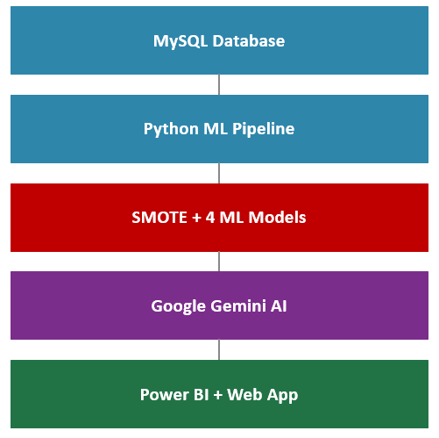
SYSTEM DESIGN & METHODOLOGY
System Architecture — 4 Layers
Data Layer — MySQL stores 10,000 customer records
Processing Layer — Python ML pipeline
Intelligence Layer — Google Gemini AI
Presentation Layer — Power BI + Streamlit
Tools & Technologies
Database: MySQL | Language: Python 3.x
Libraries: Pandas, Scikit-learn, XGBoost, Imbalanced-learn
Web App: Streamlit | AI: Google Gemini API
Visualization: Power BI Desktop
Key Features
Real-time churn prediction with risk scoring
AI-generated retention strategies
Interactive visual analytics dashboard

Slide 6
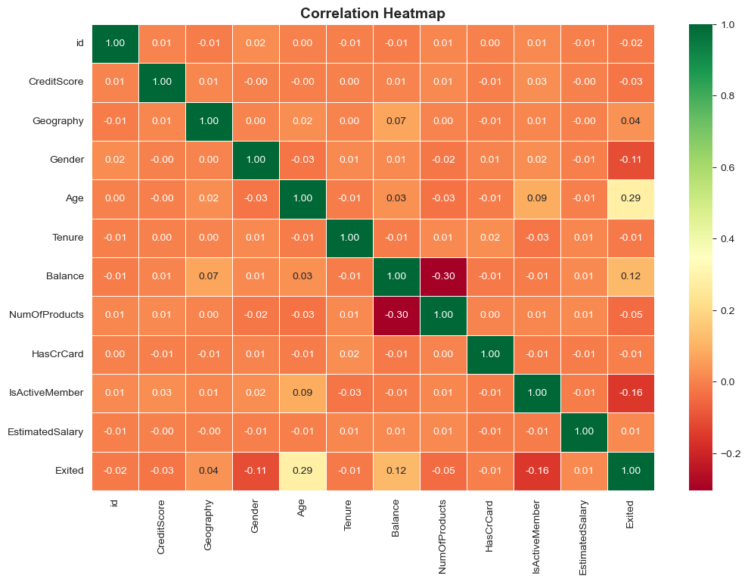
DATA COLLECTION & PREPROCESSING
Dataset — Bank Customer Churn (Kaggle)
10,000 records | 11 features | Target: Exited (1=Churned, 0=Stayed) | No missing values
Key Features
CreditScore, Geography, Gender, Age, Tenure, Balance, NumOfProducts, HasCrCard, IsActiveMember, EstimatedSalary
Data Cleaning
Dropped RowNumber, CustomerId, Surname — not useful for prediction
No null values found across all 10,000 records
No duplicate rows found
Encoding & Scaling
Label Encoding: Gender → Female=0, Male=1
One-Hot Encoding: Geography → Germany, Spain columns
StandardScaler: Normalizes all features to mean=0, std=1
Class Imbalance — SMOTE
Before: 7,963 stayed | 2,037 churned (ratio 3.91:1)
After SMOTE: 7,963 | 7,963 — perfectly balanced

Slide 7
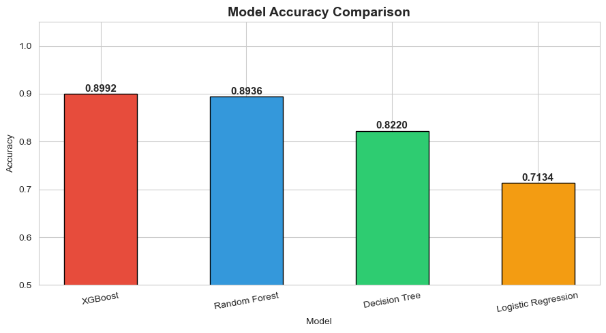
MODEL DEVELOPMENT / IMPLEMENTATION
Train-Test Split
80% Training | 20% Testing on SMOTE-balanced dataset
4 Models Trained
Logistic Regression — Baseline linear binary classifier
Decision Tree — Tree-based, max depth 10
Random Forest — Ensemble of 100 trees (bagging)
XGBoost — Sequential gradient boosting
Model Selection Criteria
Primary: AUC Score — best discrimination ability
Secondary: Recall for Churned class (catch max churners)
Random Forest selected — AUC 0.9626 (highest)

Slide 8
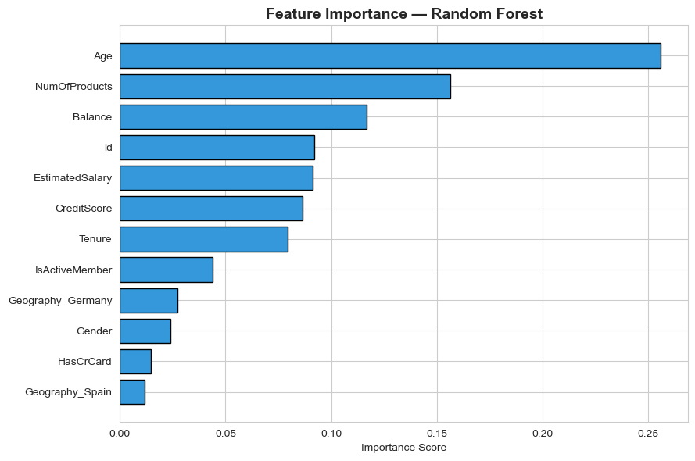
RESULTS & ANALYSIS
Random Forest — Best Model
Accuracy: 89.36% | AUC Score: 0.9626 | Test Samples: 3,186
Classification Report
Not Churned (0): Precision 0.91 | Recall 0.88 | F1 0.89
Churned (1): Precision 0.88 | Recall 0.90 | F1 0.89
Recall 0.90 → Model identifies 90% of actual churners
Top Features (Importance)
Age (0.2561) — Strongest predictor
NumOfProducts (0.1566) — Number of bank products
Balance (0.1170) — Account balance
EstimatedSalary (0.0911)
Key Business Insights
Customers aged 40-60 are highest risk group
Inactive members are most likely to churn
Germany shows highest churn concentration

Slide 9
INTEGRATION OF SUBJECTS
Course Code | Course Name | Concept Used
DS401 | Machine Learning II | Trained 4 models (LR, DT, RF, XGBoost), applied SMOTE, cross validation, feature importance analysis
DS402 | Big Data Technologies | MySQL database stores 10,000 records; Python fetches data directly via SQL query for ML pipeline
DS403 | Introduction to Power BI | Built interactive dashboard with KPI cards, bar charts, donut charts, scatter plots and slicers
DS404 | Introduction to Web Technology | ChurnAI Streamlit web app with real-time churn prediction, risk scoring and customer input form
DS405 | Introduction to Artificial Intelligence | Google Gemini API generates personalized retention strategies based on ML churn predictions
DS406 | Advanced Business Domain II | CRM analytics, customer segmentation and actionable retention strategies for banking sector

Slide 10
CONCLUSION & FUTURE WORK
Conclusion
This project successfully delivered a complete end-to-end customer churn prediction system integrating all 6 subjects of B.Sc. Data Science Semester IV.
Random Forest achieved best AUC of 0.9626 and correctly identifies 90% of churners
SMOTE corrected 3.91:1 class imbalance to perfectly balanced 50:50 distribution
Power BI dashboard transforms ML predictions into visual insights for non-technical stakeholders
ChurnAI web app with Gemini AI provides real-time predictions and business retention strategies
Age, NumOfProducts and Balance identified as the top 3 churn predictors
Future Work
Real-time streaming pipeline using Apache Kafka for live churn monitoring
Deep Learning models (ANN/LSTM) to capture complex temporal behavior patterns
NLP integration on customer feedback and complaints to enrich features
Automated SMS/email alerts when churn probability crosses a defined threshold
Mobile application for on-the-go access by bank relationship managers

Slide 11
Thank You

